Slide 1
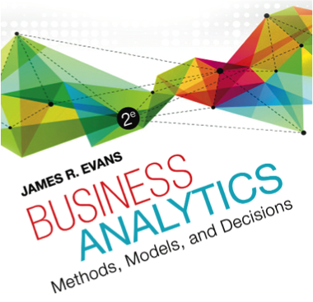

Chapter 13 Linear Optimization

Slide 2
Linear Optimization
Optimization is the process of selecting values of decision variables that minimize or maximize some quantity of interest.
Optimization models have wide applicability in operations and supply chains, finance, marketing, and other disciplines.
This chapter focuses only on linear optimization models.

Slide 3
Building Linear Optimization Models
Identify the decision variables – the unknown values that the model seeks to determine.
Identify the objective function – the quantity we seek to minimize or maximize.
Identify all appropriate constraints – limitations, requirements, or other restrictions that are imposed on any solution, either from practical or technological considerations or by management policy.
Write the objective function and constraints as
mathematical expressions.

Slide 4
Characteristics of Linear Optimization Models
A linear optimization model (often called a linear program, or LP) has two basic properties.
The objective function and all constraints are linear functions of the decision variables.
This means that each function is simply a sum of terms, each of which is some constant multiplied by a decision variable.
All variables are continuous
This means that they may assume any real value (typically, nonnegative).

Slide 5
Example 13.1 Sklenka Ski Company: Identifying Model Components
SSC sells two snow ski models - Jordanelle & Deercrest
Manufacturing requires fabrication and finishing.
The fabrication department has 12 skilled workers, each of whom works 7 hours per day. The finishing department has 3 workers, who also work a 7-hour shift.
Each pair of Jordanelle skis requires 3.5 labor-hours in the fabricating department and 1 labor-hour in finishing.
The Deercrest model requires 4 labor-hours in fabricating and 1.5 labor-hours in finishing.
The company operates 5 days per week.
SSC makes a net profit of $50 on the Jordanelle model and $65 on the Deercrest model.

Slide 6
Example 13.1 Continued
Step 1: Identify the decision variables
The company wants to determine how many of each model should be produced on a daily basis to maximize net profit.
Define
Jordanelle = number of pairs of Jordanelle skis produced/day
Deercrest = number of pairs of Deercrest skis produced/day
Clearly specify the dimensions of the variables!

Slide 7
Example 13.1 Continued
Step 2: Identify the objective function
SSC wishes to maximize net profit, and we are given the net profit figures for each type of ski.
SSC makes a net profit of $50 on the Jordanelle model and $65 on the Deercrest model.

Slide 8
Example 13.1 Continued
Step 3: Identify the constraints
Look for clues in the problem statement that describe limited resources that are available, requirements that must be met, or other restrictions.
Both the fabrication and finishing departments have limited numbers of workers, who work only 7 hours each day; this limits the amount of production time available in each department:
Fabrication: Total labor hours used in fabrication cannot exceed the amount of labor hours available.
Finishing: Total labor hours used in finishing cannot exceed the amount of labor hours available.
The problem also notes that the company anticipates selling at least twice as many Deercrest models as Jordanelle models:
Number of pairs of Deercrest skis must be at leasttwice the number of parts of Jordanelle skis.
Negative values of the decision variables cannot occur (“nonnegativity constraints”)

Slide 9
Translating Model Information into Mathematical Expressions
Represent decision variables by descriptive names, abbreviations, or subscripted letters (X₁, X₂, etc.)
For mathematical formulations involving many variables, subscripted letters are often more convenient.
In spreadsheet models, we recommend using more descriptive names to make the models and solutions easier to understand.

Slide 10
Example 13.2: SSC – Modeling the Objective Function
Profit per pair of skis sold:
$50 for Jordanelle skis, $65 for Deercrest skis
Objective Function:
Maximize total profit
= 50 Jordanelle + 65 Deercrest
Note how the dimensions verify that the expression is correct:
($/pair of skis)(number of pairs of skis) = $.

Slide 11
Translating Constraints Mathematically
Constraints are expressed as algebraic inequalities or equations, with all variables on the left side and constant terms on the right.
Look for key words in word statements of constraints:
“Cannot exceed” translates mathematically as “≤”
“At least,” would translate as “≥”
“Must contain exactly,” would specify an “= ” relationship.
All constraints in optimization models must be one of these three forms.

Slide 12
Constraint Functions
A constraint function is the left-hand side of a constraint.
E.g.: Total labor-hours used in fabrication cannot exceed the amount of labor hours available.

Slide 13
Example 13.3: SSC – Modeling the Constraints
Fabrication constraint
Available fabrication labor hours: (12 workers)(7 hours/day) = 84 hours/day
Required fabrication labor hours per ski pair: 3.5 hours for Jordanelle, 4 hours for Deercrest
Fabrication constraint: 3.5 Jordanelle + 4 Deercrest ≤ 84
Finishing constraint
Available finishing labor hours: (3 workers)(7 hours/day) = 21 hours/day
Required finishing labor hours per ski pair: 1 hour for Jordanelle; 1.5 hours for Deercrest
Finishing constraint: 1 Jordanelle + 1.5 Deercrest ≤ 21

Slide 14
Example 13.3 Continued
Market mixture constraint
The number of pairs of Deercrest skis must be at least twice the number of Jordanelle skis.
Deercrest ≥ 2 Jordanelle,
or − 2 Jordanelle + 1 Deercrest ≥ 0
Nonnegativity constraints:
Jordanelle ≥ 0
Deercrest ≥ 0

Slide 15
SSC Optimization Model
Maximize total profit = 50 Jordanelle + 65 Deercrest
3.5 Jordanelle + 4 Deercrest ≤ 84
1 Jordanelle + 1.5 Deercrest ≤ 21
−2 Jordanelle + 1 Deercrest ≥ 0
Jordanelle ≥ 0
Deercrest ≥ 0
The highlighted portions are the constraint functions

Slide 16
Solving Linear Optimization Models
A feasible solution to an optimization problem is any solution that satisfies all of the constraints.
An optimal solution is the best of all the feasible solutions.
Software for determining optimal solutions
Solver (“standard Solver”) is a free add-in packaged with Excel for solving optimization problems.
Premium Solver, which is a part of Analytic Solver Platform has better functionality, accuracy, reporting, and interface.

Slide 17
More About Constraints
Some examples:
The amount of money spent on research and development projects cannot exceed the assigned budget of $300,000.
Amount spent on research and development ≤ 300,000
Contractual requirements specify that at least 500 units of product must be produced.
Number of units of product produced ≥ 500
A mixture of fertilizer must contain exactly 30% nitrogen.
Amount of nitrogen in mixture/total amount in mixture = 0.30

Slide 18
Example 13.4: Modeling a Mixture Constraint
A fertilizer mixture is made of two ingredients and must contain exactly 30% nitrogen. Ingredient X contains 20% nitrogen. Ingredient Y contains 33% nitrogen.
Define x = the number of pounds of X in the mixture and y = the number of pounds of Y in the mixture
Amount of nitrogen in mixture = 0.20x + 0.33y
Total amount of mixture = x + y
Fraction of nitrogen in mix = (0.20x + 0.33y)/(x + y)
Since the fraction of nitrogen must be 0.30, the constraint would be
(0.20x + 0.33y)/(x + y) = 0.30, or simplified as -0.1x - 0.03y = 0
Note that the first version is not linear; however the simplified constraint is linear.

Slide 19
Implementing Linear Optimization Models on Spreadsheets
Put the objective function coefficients, constraint coefficients, and right-hand values in a logical format in the spreadsheet.
For example, you might assign the decision variables to columns and the constraints to rows
Define a set of cells (either rows or columns) for the values of the decision variables.
The names of the decision variables should be listed directly above the decision variable cells.
Use shading or other formatting to distinguish these cells.
Define separate cells for the objective function and each constraint function (the left-hand side of a constraint).
Use descriptive labels directly above these cells.

Slide 20
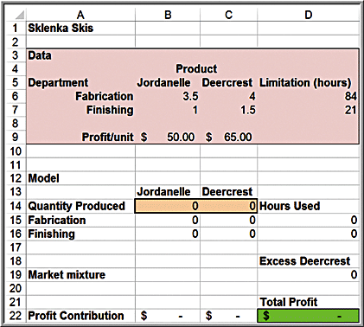
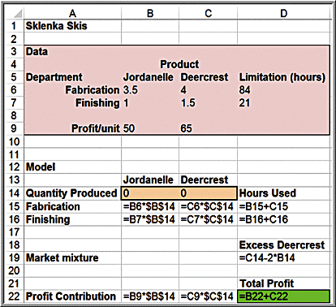
Example 13.5: A Spreadsheet Model for Sklenka Skis
Decision variables Objective function Constraint functions

Slide 21
Correspondence Between the Model and the Spreadsheet
Maximize Jordanelle + 65 Deercrest
3.5 Jordanelle + 4 Deercrest ≤ 84
1 Jordanelle + 1.5 Deercrest ≤ 21
−2 Jordanelle + 1 Deercrest ≥ 0
Jordanelle ≥ 0
Deercrest ≥ 0
Maximize D22 = B9* B14 + C9* C14
D15 = B6* B14 + C6* C14 ≤ D6
D16 = B7* B14 + C7* C14 ≤ D7
D19 = C14 - 2* B14 ≥ 0
B14 ≥ 0
C14 ≥ 0

Slide 22
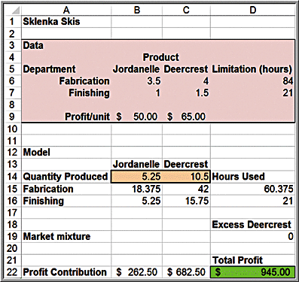
Optimal Solution to SSC Problem

Slide 23
Example 13.8 Continued
Understanding slack values
Maximize profit = 50 Jordanelle + 65 Deercrest
3.5 Jordanelle + 4 Deercrest ≤ 84 (fabrication)
1 Jordanelle + 1.5 Deercrest ≤ 21 (finishing)
−2 Jordanelle + 1 Deercrest ≥ 0 (market mix)
Jordanelle ≥ 0
Deercrest ≥ 0
Optimal solution: Jordanelle = 5.25; Deercrest = 10.5
Fabrication constraint: 3.5(5.25) + 4(10.5) = 60.375 ≤ 84
23.625 excess fabrication hours
Finishing constraint: 1(5.25) + 1.5(10.5) = 21 ≤ 21
No excess finishing hours
Market mix constraint: −2(5.25) + 1(10.5) = 0 ≥ 0
→ Exactly twice the number of Deercrest skis as Jordanelle skis

Slide 24
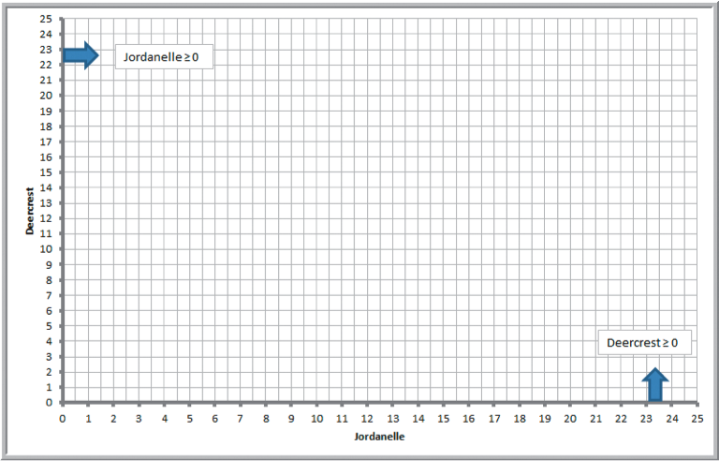
Graphical Interpretation of Linear Optimization
The set of feasible solutions is called the feasible region.
For a problem with only two decision variables, x₁ and x₂, we can draw the feasible region on a two-dimensional coordinate system by plotting the equations corresponding to each constraint.
Nonnegativity constraints:

Slide 25
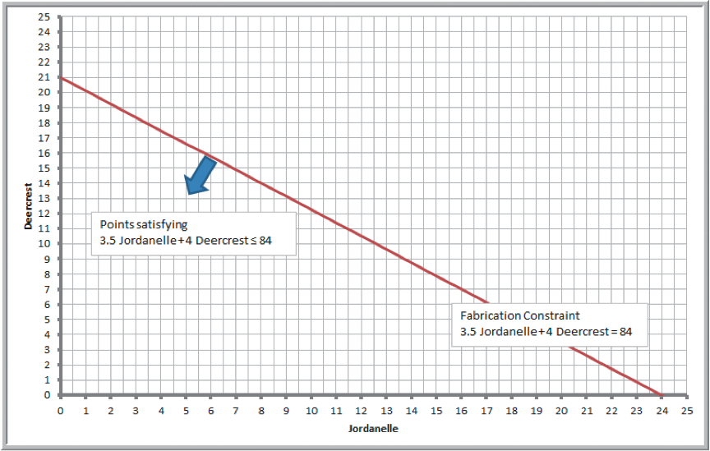
Example 13.9: Graphing the Constraints in the SSC Problem
Fabrication constraint: 3.5 Jordanelle + 4 Deercrest ≤ 84
Plot the equation: 3.5 Jordanelle + 4 Deercrest = 84
Set Jordanelle = 0; Deercrest = 21
Set Deercrest = 0; Jordanelle = 24

Slide 26
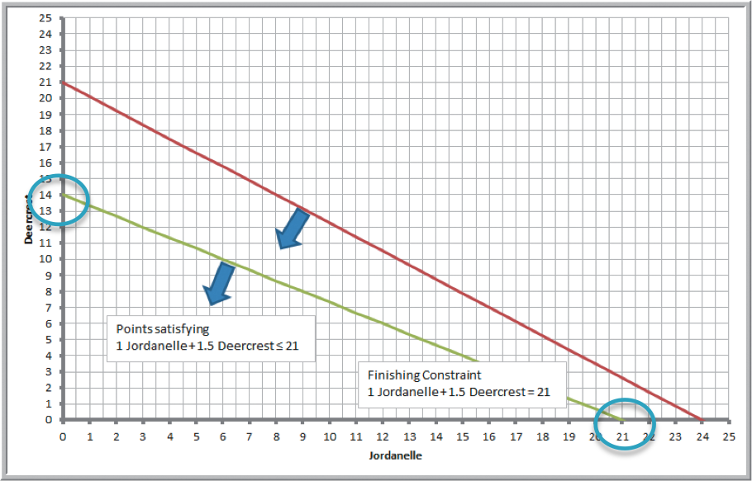
Example 13.9 Continued
Finishing constraint: 1 Jordanelle + 1.5 Deercrest ≤ 21
Plot the equation: 1 Jordanelle + 1.5 Deercrest = 21
Set Jordanelle = 0; Deercrest = 14
Set Deercrest = 0; Jordanelle = 21

Slide 27
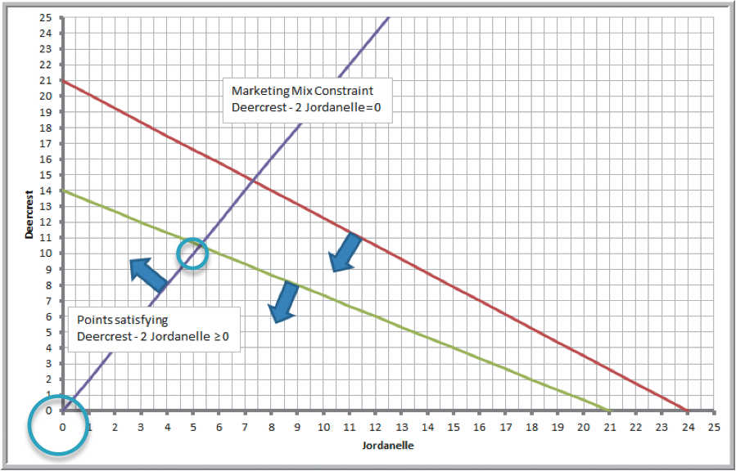
Example 13.9 Continued
Market mix constraint: -2 Jordanelle + 1 Deercrest ≥ 0
Plot the equation: -2 Jordanelle + 1 Deercrest = 0
Set Jordanelle = 5; Deercrest = 10
Set Deercrest = 0; Jordanelle = 0

Slide 28
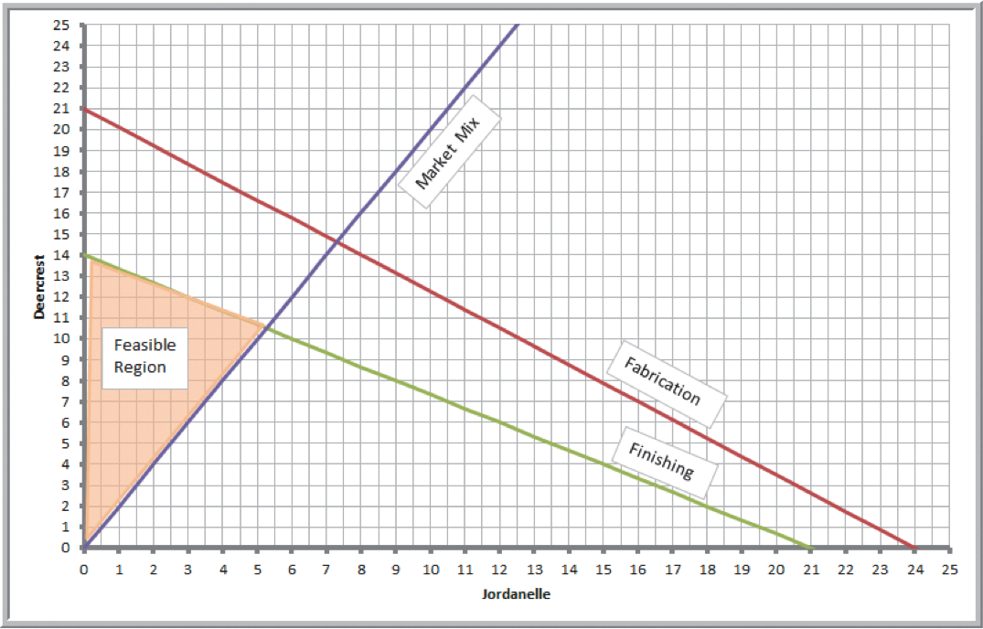
Example 13.10 Identifying the Feasible Region and Optimal Solution
Feasible region

Slide 29
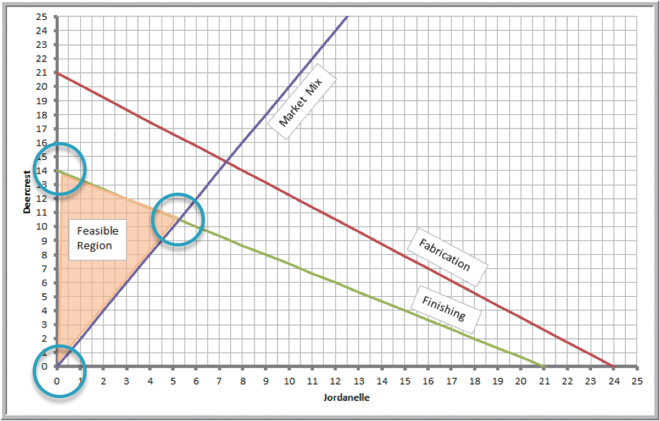
Corner Points
The points at which the constraint lines intersect along the feasible region are called corner points.
If an optimal solution exists, then it will occur at a corner point.

Slide 30
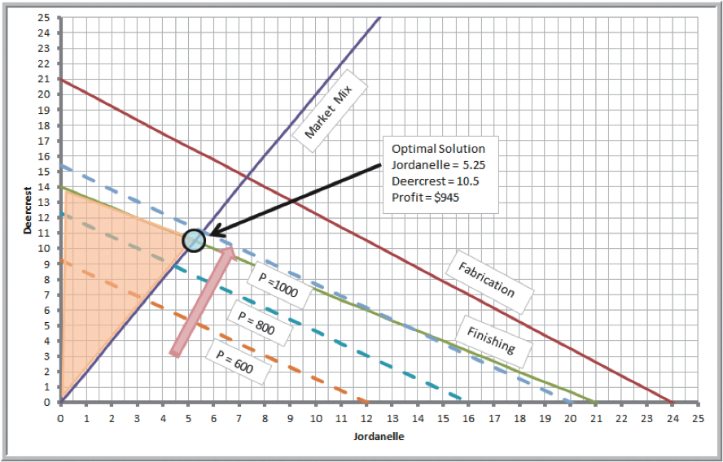
Example 13.10 Continued
Because our objective is to maximize profit, we seek a corner point that has the largest value of the objective function Total Profit = 50 Jordanelle + 65 Deercrest.
Graph the profit line and move in an improving direction until it passes through the last corner point of the feasible region.
Solve the two intersecting equations simultaneously to find the optimal solution.

Slide 31
How Solver Works
Solver uses a mathematical algorithm called the simplex method, which was developed in 1947 by the late Dr. George Dantzig.
The simplex method characterizes feasible solutions algebraically by solving systems of linear equations.
It moves systematically from one corner point to another to improve the objective function until an optimal solution is found (or until the problem is deemed infeasible or unbounded).
It is quick and efficient.

Slide 32
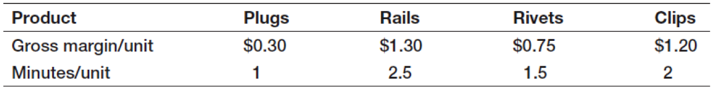
Example 13.11: Crebo Manufacturing
Crebo Manufacturing produces 4 types of structural support fittings.
Machining centers have a capacity of 280,000 minutes per year.
Gross margin/unit and machining requirements:
How many units of each product type should be produced to maximize gross profit margin?

Slide 33
Example 13.11 Continued
Define X₁, X₂, X₃, and X₄ as the number of plugs, rails, rivets, and clips to produce.
Objective:
Maximize gross profit margin = 0.3 X₁ + 1.3 X₂ + 0.75X₃ + 1.2X₄
Constraints:
1X₁ + 2.5 X₂ + 1.5X₃ + 2X₄ ≤ 280,000
X₁, X₂, X₃, X₄ ≥ 0

Slide 34
Solver Sensitivity Report
The Sensitivity Report allows us to understand how
the optimal objective value and optimal decision variables are affected by changes in the objective function coefficients,
the impact of forced changes in certain decision variables, or
the impact of changes in the constraint resource limitations or requirements.
The Sensitivity Report information applies to changes in only one of the model parameters at a time; all others are assumed to remain at their original values.

Slide 35
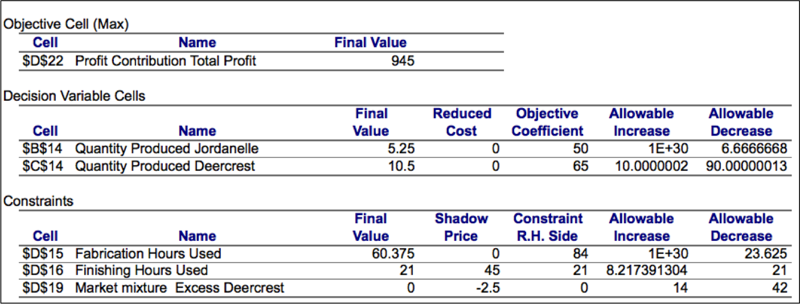
Sensitivity Report for the SSC Problem

Slide 36
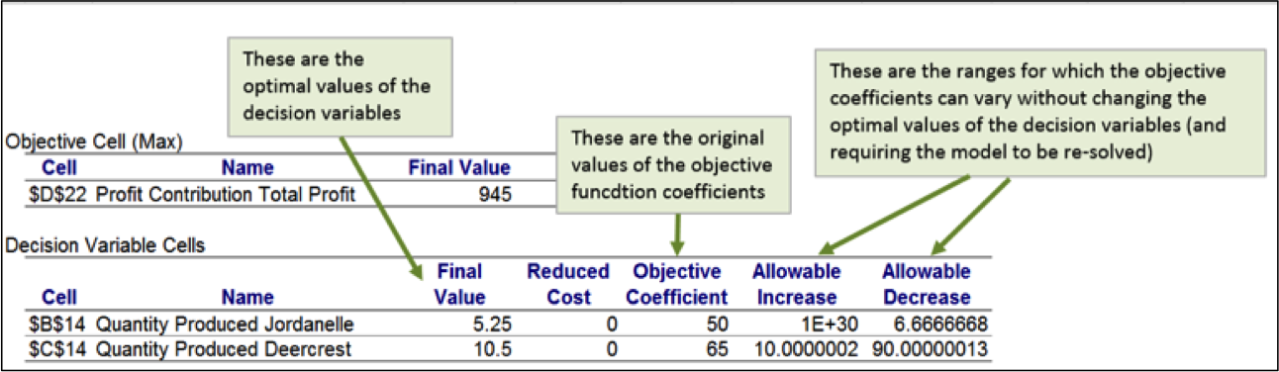
Example 13.17: Interpreting Sensitivity Information for Decision Variables
Reduced Cost: How much the objective function coefficient needs to be reduced for a nonnegative variable that is zero in the optimal solution to become positive. If a variable is positive in the optimal solution, its reduced cost is zero.
If the objective coefficient of any one variable that has positive value in the current solution changes but stays within the range specified by the Allowable Increase and Allowable Decrease, the optimal decision variables will stay the same; however, the objective function value will change.

Slide 37
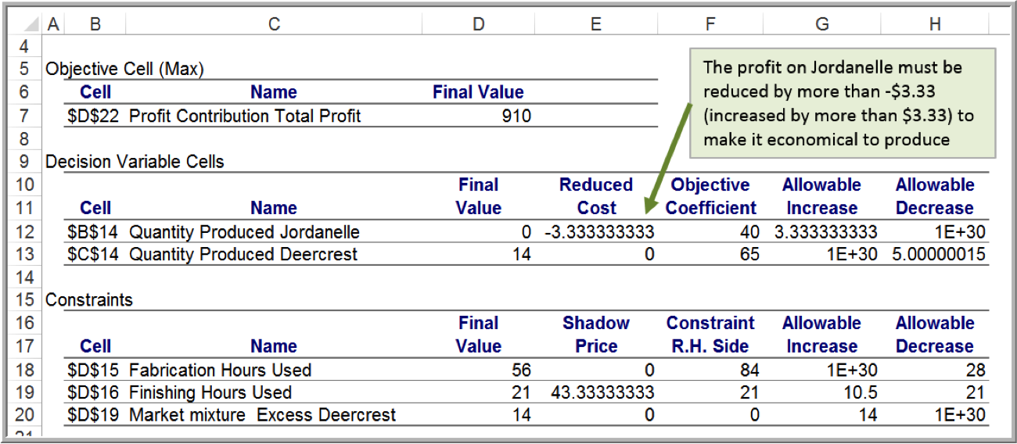
Example 13.18: Understanding Nonzero Reduced Costs
Sensitivity report for the Sklenka Ski model after changing the profit on Jordanelle skis from $50 to $40

Slide 38
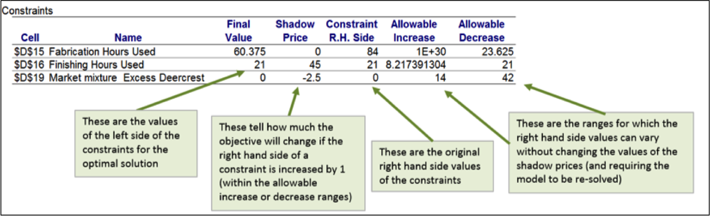
Example 13.19: Interpreting Sensitivity Information for Constraints
Shadow Price - how much the objective function will change as the right hand side of a constraint is increased by 1.
Whenever a constraint has positive slack, the shadow price is zero. When a constraint involves a limited resource, the shadow price represents the economic value of having an additional unit of that resource.

Slide 39
Using the Sensitivity Report
If a change in an objective function coefficient remains within the Allowable Increase and Allowable Decrease ranges in the Decision Variable Cells section of the report, then the optimal values of the decision variables will not change. However, you must recalculate the value of the objective function using the new value of the coefficient.
If a change in an objective function coefficient exceeds the Allowable Increase or Allowable Decrease limits in the Decision Variable Cells section of the report, then you must re-solve the model to find the new optimal values.

Slide 40
Using the Sensitivity Report (Continued)
If a change in the right-hand side of a constraint remains within the Allowable Increase and Allowable Decrease ranges in the Constraints section of the report, then the shadow price allows you to predict how the objective function value will change. Multiply the change in the right-hand side (positive if an increase, negative if a decrease) by the value of the shadow price. However, you must re-solve the model to find the new values of the decision variables.
If a change in the right-hand side of a constraint exceeds the Allowable Increase or Allowable Decrease limits in the Constraints section of the report, then you cannot predict how the objective function value will change using the shadow price. You must re-solve the problem to find the new solution.

Slide 41
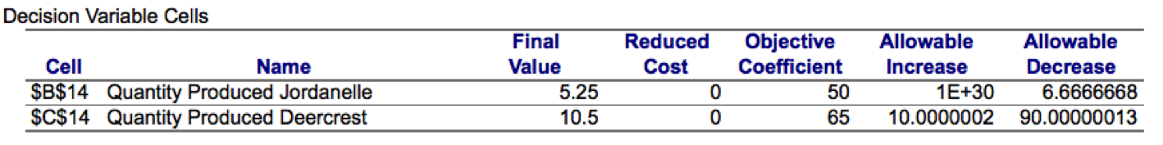
Example 13.20: Using Sensitivity Information to Evaluate Scenarios
Suppose that the unit profit on Jordanelle skis is increased by $10. How will the optimal solution change? What is the best product mix?
Is the increase in the objective function coefficient is within the range of the Allowable Increase and Allowable Decrease in the Decision Variable Cells portion of the report?
Because $10 is less than the Allowable Increase of infinity, we can safely conclude that the optimal quantities of the decision variables will not change.
However, because the objective function changed, we need to compute the new value of the total profit: 5.25($60) + 10.5($65) = $997.50.

Slide 42
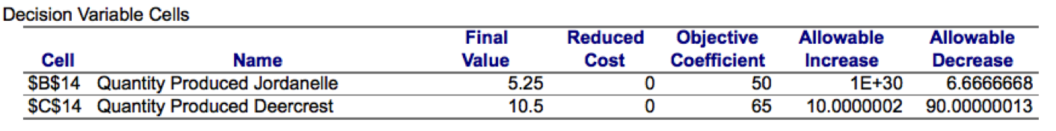
Example 13.20 Continued
Suppose that the unit profit on Jordanelle skis is decreased by $10 because of higher material costs. How will the optimal solution change? What is the best product mix?
The change in the unit profit exceeds the Allowable Decrease ($6.67). We can conclude that the optimal values of the decision variables will change, although we must re-solve the problem to determine what the new values would be.

Slide 43
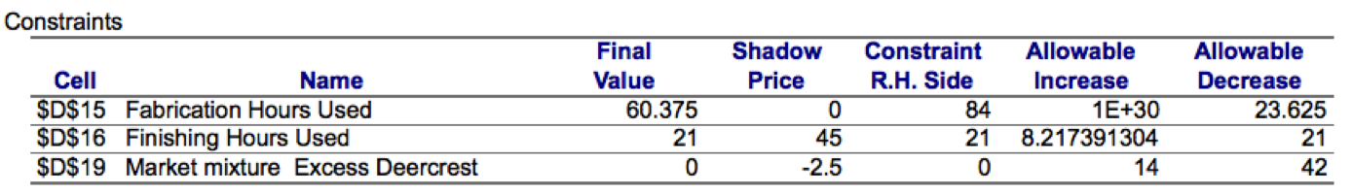
Example 13.20 Continued
Suppose that 10 additional finishing hours become available through overtime. How will manufacturing plans be affected?
Check if the change in the right-hand-side value is within the range of the Allowable Increase and Allowable Decrease in the Constraints section of the report.
Ten additional finishing hours exceeds the Allowable Increase. Therefore, we must re-solve the problem to determine the new solution.

Slide 44
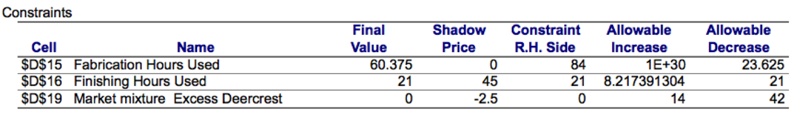
Example 13.20 Continued
What if the number of finishing hours available is decreased by 2 hours because of planned equipment maintenance? How will manufacturing plans be affected?
A decrease of 2 hours in finishing capacity is within the Allowable Decrease. Total profit will decrease by the value of the shadow price for each hour that finishing capacity is decreased. Therefore, we can predict that the total profit will decrease by 2 ×$45 = $90 to $855. However, we must re-solve the model in order to determine the new values of the decision variables.

Slide 45
Parameter Analysis in Analytic Solver Platform
Solver can be used to perform sensitivity analysis by either:
Examining the sensitivity reports or
Changing data in the model and re-solving it
Analytic Solver Platform offers an alternative approach to sensitivity analysis called parameter analysis, which allows you to run multiple optimizations while varying model parameters within predefined ranges.

Slide 46
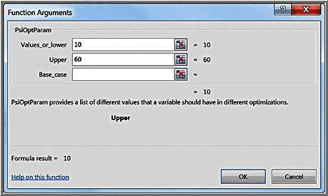
Example 13.21: Single Parameter Analysis for the SSC Problem
Investigate the impact of changing finishing hour capacity over a range from 10 to 60.
Choose an empty cell in the spreadsheet (e.g., F3)
From Analytic Solver Platform ribbon, click Parameters button and choose Optimization.
Define range in Function Arguments dialog.
Replace the value in cell D7 by =F3

Slide 47
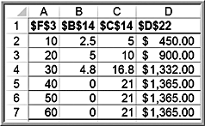
Example 13.21 Continued
Parameter analysis results
Reformat the results to make them easier to understand. For example, name the columns with descriptive labels instead of cell references; use charts to visualize the results.

Slide 48
Example 13.22: Multiple Parameter Analysis for the SSC Problem
Suppose that we wish to examine the effect on the optimal profit of changing both the Fabrication and Finishing hour limitations, similar to a two-way data table.
Follow the procedure in Example 13.21 to define the parameter for the Finishing limitation.
In the Function Arguments dialog, set the range for the Fabrication limitation between 50 and 100.

Slide 49
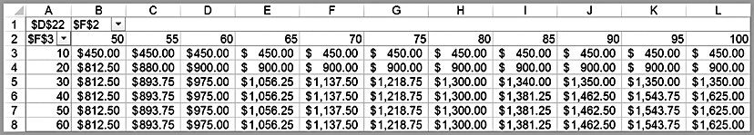
Example 13.22 Continued
Results

